Slide 1
Poisson regression
Institute of Tropical Medicine
Epco Hasker
Tom Smekens

Slide 2
lecture on Poisson regression
Rationale behind Poisson regression
Equation, parameter estimates
Conditions
Models with > 1 explanatory variable
Comparison of models
Goodness of fit

Slide 3
Which method?
Dependent variable | Example | Method
Numerical | Blood pressure, weight, temperature | Linear regression
Dichotomous | Death, disease, hospital admission | Logistic regression
Time until a dichotomous event | Time till death, Time till relapse | Survival analysis
Count/rate | Number of deaths per category of smoking habits | Poisson regression
Notes:
Which method to choose depends most of all on the outcome variable as we already saw during the introduction last week. If the outcome variable is numerical linear regression is the first option, if it is binary and time till event does not matter, logistic regression is the most appropriate technique. If time to event matters survival analysis is the methodolgy of choice, if the outcome is a count or a rate the first option is Poisson regression. But these are just general guidelines, often different methods can be applied and we can choose whichever we deem appropriate.

Slide 4
The link function
Linear regr. : y = a +b¹x¹+b²x²…+ b^{k}x^{k}
Logistic regr. : ln(p/[1-p]) = a +b¹x¹+b²x²…+ b^{k}x^{k}
Poisson regr. : ln(rate) = a +b¹x¹+b²x²…+ b^{k}x^{k}
Notes:
Linear regression, logistic regression and poisson regression are al examples of generalized linear models in which we use a link function to model te effect of one or more exposures x on an outcome y. In linear regression y is a numerical variable, e.g. blood pressure or cholesterol level. In logistic regression y is dichotomous, e.g. dead or not dead and can be expressed as a probaility p. We model on the log odds or p/(1-p), also called the logit. In poisson regression we model on the log of a rate. The outcome has to be a count, e.g. number of dead but we also need to know on which population size these dead occurred for each group of x, this is called the offset.

Slide 5
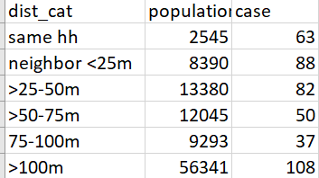
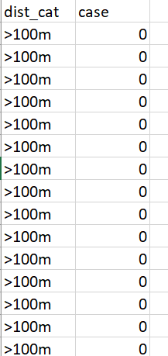
Wide and long format
Notes:
On this slide you see a dataset in wide format, on the left side and part of it in long format on the right side. In the long format one line represents one individual, in the wide format variable ‘population’ indicates how many individuals are represented. So there are 2545 persons living in the same household as an index case of leprosy and among those 63 developed leprosy themselves. If you write it in the long format you will end up with 2545+8390+13380+12045+9293+56341 lines, which is more than 100,000. Therefore the wide format is often preferred.

Slide 6
Dataset ‘poisson_smoking_mort’
Data in ‘poisson_smoking_mort.csv’:
- Male pensioners followed up for 6 years
Death rates among different categories of smoking habits
Rates, Rate ratios?
Smoking Habits | Deaths | Population | Rate/ 1,000 pop | RR
Non-smoker | 820 | 5,163 |  | Ref
Cigar or Pipe | 1,041 | 4,542
Cigar/Pipe + Cigarettes | 4,128 | 27,691
Cigarettes only | 3,141 | 18,726
Notes:
We will use a dataset ‘poisson_smoking_mort.csv’ to illustrate the principles of poisson regression and how to do it in Rstudio. Is this wide or long format? How many persons are in the cohort? 5,163+4,542+27,691+18,726= 56,122. What is the death rate for non-smokers? And for each of the categories of smokers? Which are the rate ratios with non-smokers as reference group?

Slide 7
Dataset ‘poisson_smoking_mort’
Data in ‘poisson_smoking_mort.csv’:
- Male pensioners followed up for 6 years
Death rates among different categories of smoking habits
Rates, Rate ratios?
Smoking Habits | Deaths | Population | Rate/ 1,000 pop | RR
Non-smoker | 820 | 5,163 | 158.8 | Ref
Cigar or Pipe | 1,041 | 4,542 | 229.2 | 1.44
Cigar/Pipe + Cigarettes | 4,128 | 27,691 | 149.1 | 0.93
Cigarettes only | 3,141 | 18,726 | 167.7 | 1.05
Notes:
We will use a dataset ‘poisson_smoking_mort.csv’ to illustrate the principles of poisson regression and how to do it in RStudio. Is this wide or long format? How many persons are in the cohort? 5,163+4,542+27,691+18,726= 56,122. What is the death rate for non-smokers? And for each of the categories of smokers? Which are the rate ratios with non-smokers as reference group? So what will be your recommendation, should I start smoking cigars, a pipe and cigarettes as well?

Slide 8
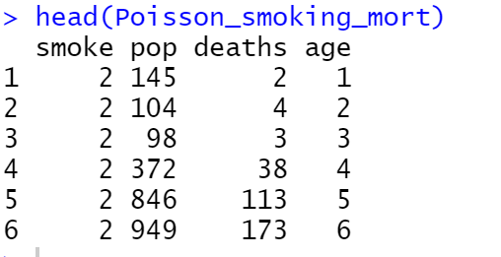
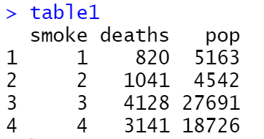
Transforming the dataset from long to wide in RStudio
table1<- aggregate(cbind(deaths, pop) ~ smoke, data=Poisson_smoking_mort, FUN=sum)
Notes:
Now import dataset poisson_smoking_mort.csv into RStudio. If you want to see what the dataset looks like, just type its name in the R Script window and you will see that it has 36 rows, 9 age groups x 4 categories of smoking and population and deaths in each group. To get the figures of our table you will need to collapse the age groups by group of smoking habits. This can be done with the ‘aggregate’ command as shown above. The name I used is ‘Table1’. So if I now type ‘Table1’ in the R Script window followed by ‘Submit’ I get the table on the right side. On the left side are the first six lines of the long format.

Slide 9
Transforming the dataset from long to wide in RStudio
Smoking Habits | Deaths | Population | Rate/ 1,000 pop | RR
Non-smoker | 820 | 5,163 |  | Ref
Cigar or Pipe | 1,041 | 4,542
Cigar/Pipe + Cigarettes | 4,128 | 27,691
Cigarettes only | 3,141 | 18,726
Notes:
As you can see the numbers are identical.

Slide 10
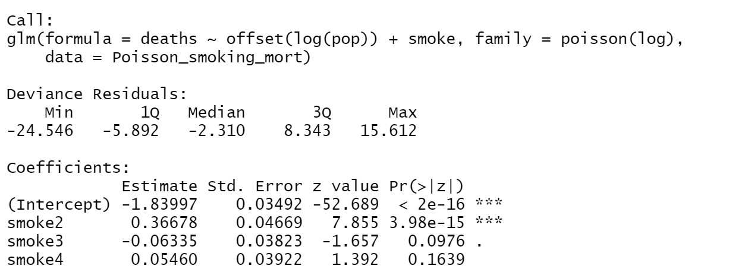
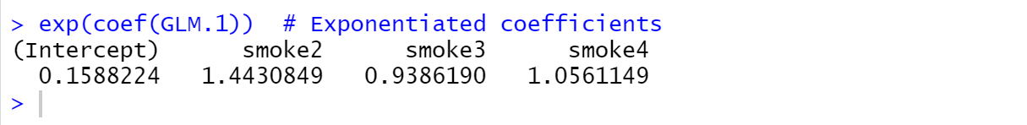
Poisson regression in RStudio
Notes:
Now let’s do a poisson regression. We will use ‘Poisson_smoking_mort’ and not ‘Table1’, even tough at this stage the outcome would be just the same. Use the command shown on this slide to create a generalized linear model of the poisson family. As outcome use ‘deaths’ and as explanatory variable use ‘smoke’ (which we have already converted to a factor). Because the dataset is in wide format, we still need to specify the offset, which is the log of the population, variable ‘pop’.

Slide 11
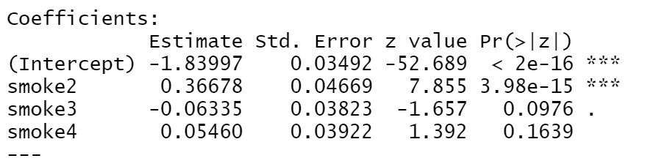
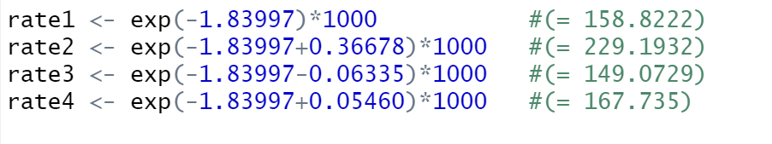
Result of Poisson regression in RStudio
Smoking Habits | Rate/ 1,000 pop
Non-smoker | 158.8
Cigar or Pipe | 229.2
Cigar/Pipe + Cigarettes | 149.1
Cigarettes only | 167.7
Notes:
The values you get are an intercept and a coefficient for smoking categories 2, 3 and 4. If you exponentiate the intercept you will have the rate for the non-smokers. If you exponentiate the sum of the intercept + each of the other coefficients you will get the rates for the three categories of smokers. Please try to do this and confirm that your results match with the results you calculated manually.

Slide 12
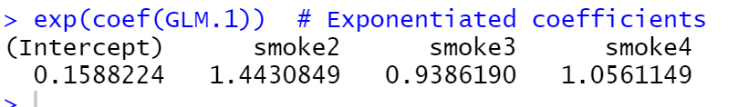
Result of Poisson regression in RStudio
Smoking Habits | RR
Non-smoker | Ref
Cigar or Pipe | 1.44
Cigar/Pipe + Cigarettes | 0.93
Cigarettes only | 1.05
Notes:
Also calculate the rate ratios which is rate2, 3 or 4 divided rate1. To get rate ratios in RStudio use ‘exp(coef(GLM.1))’, you will find the same rate ratios as those we calculated manually.

Slide 13
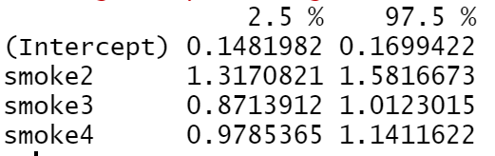
Result of Poisson regression in RStudio
exp(confint(GLM.1))
Notes:
RStudio also provided standard errors, which means that you can also calculate confidence intervals.
An easier way to do it is to let Rstudio calculate using command: exp(confint(GLM.1)), results are shown on this slide.
One question still left to be answered is whether these results are valid, i.e. whether the condition for poisson regression that mean is (more or less) equal to variance has been met.

Slide 14
Condition in Poisson regression
Mean ≈ Variance
Mean= deaths/pop
Variance = SD^2
SD = SE*√n
SE = √(p*(1-p)/n)
p = deaths/pop, n = pop
Notes:
Just like logistic regression, Poisson regression also has certain conditions. The main condition is that for each level of the explanatory variable(s), the mean should be approximately the same as the variance. In linear regression the variance of y should be more or less equal for each level of the predictor x. In Poisson regression the variance is assumed to increase as x increases and should always be more or less equal to the mean of y. If the variance is much higher than the mean there is overdispersion. In that case the standard errors are not calculated correctly and the confidence intervals are too narrow. There is then a risk of an α-error, i.e. rejecting the null hypothesis whereas we should not have done so. You could calculate mean and variance for each of the 4 categories of smoking as shown on this slide, but there are easier ways to solve this problem.

Slide 15
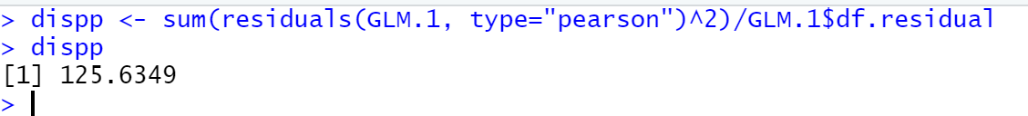
Checking for overdispersion
sum(residuals(GLM.1, type="pearson")^2)/GLM.1$df.residual)
Notes:
One quick solution is to calculate what is called the ‘dispersion parameter’, it is the sum of the residuals divided by the residual degrees of freedom. Both can be calculated by R using the command shown on this slide. In our example there were 36 observations, so 35 degrees of freedom. We used 3 terms (smoking 2, 3 and 4), so there are 32 degrees of freedom left. In this case the final result is 125.6, which is far away from 1, indicating the the model is overdispersed. This means that the standard errors are not valid and therefore also the confidence intervals and p-values provided are not valid.

Slide 16
Common causes of over-dispersion
Excessive zeros
Model is misspecified
It just is not a Poisson distribution
Notes:
Over dispersion may have different causes. There may be excessive zeros, which can happen because two distributions are mixed. An example is the numbers of fish caught by people going to a national park. The numbers of fish caught per person will follow a poisson distribution but there will be excessive zeros. This is because most people will not go fishing and therefore will catch zero fish. If you apply the model only to those that actually went fishing, it will propbably fit much better. But it could also be that some important predictor is missing. Remember in our dataset we had two possible predictors, smoking habits and age. Since our outcome variable ‘deaths’ is of course closely associated with age, it could be an important confounder.
A poisson distribution assumes a certain relation between the x-variable (mean or rate) and variance. At lower level the variance is less and it increases as the level of the x-variable increases. This may not be the case in the dataset you are analyzing which means that a poisson model will never fit properly. This can be solved by fitting a negative binomial model which estimates mean and variance seprately so the restriction of the association between the two no longer applies.

Slide 17
Adding more terms to the model
GLM.2 <- glm(deaths ~ offset(log(pop)) + smoke + factor(age), family=poisson(log), data=Poisson_smoking_mort)
Notes:
So let’s add age to the model. Because it is defined here as a categorical variable (age groups), I will first treat it as such. The model will now look as on this slide.

Slide 18
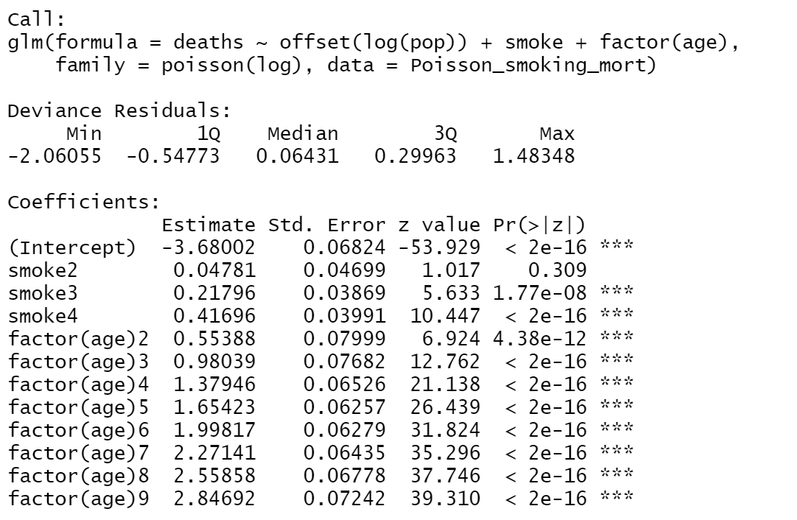
Adding more terms to the model
Notes:
This slide shows the coefficients and standard errors. To get the rate ratios we still need to exponentiate. What can already be seen is that all the age terms are clearly statistically significant.

Slide 19
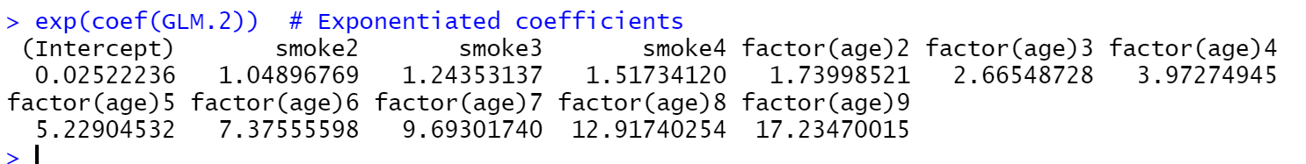
Adding more terms to the model
Facfor | RR | P-value
Non-smoker | Ref.
Cigar or Pipe | 1.04896769 | 0.309
Cigar/Pipe + Cigarettes | 1.24353137 | 1.77e-08
Cigarettes only | 1.51734120 | < 2e-16
Age group 1 | Ref.
Age group 2 | 1.73998521 | 4.38e-12
Age group 3 | 2.66548728 | < 2e-16
Age group 4 | 3.97274945 | < 2e-16
Age group 5 | 5.22904532 | < 2e-16
Age group 6 | 7.37555598 | < 2e-16
Age group 7 | 9.69301740 | < 2e-16
Age group 8 | 12.91740254 | < 2e-16
Age group 9 | 17.23470015 | < 2e-16
Notes:
Here we see the exponentiated coefficiensts, i.e. the rate ratios. Have the associations for the smoking categories changed? How is age group associated to mortality? I hope you will agree that after controlling for confounding by age a different pattern has emerged. Apparently age is not just associated to mortality but also to smoking habits, making it a confounder. This is reason enough for wanting to keep age in our model but we could also check whether the model with age is significantly better than the model without age.

Slide 20
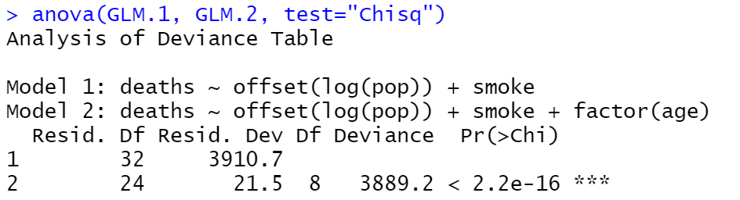
Comparing two models
Notes:
The comparison between two models is just the same as we saw in logistic regression. Obviously the difference is clearly significant, so even if we were making only a classical model we would keep ‘age’ in. We could still test for an interaction,

Slide 21
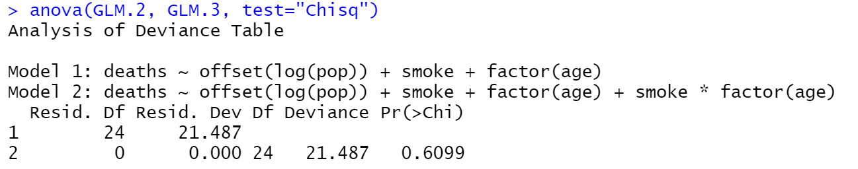
Comparing two models
Notes:
In this slide you see the result of adding an interaction term. The p-value for the comparison of the two models is 0.6, so non-significant.

Slide 22
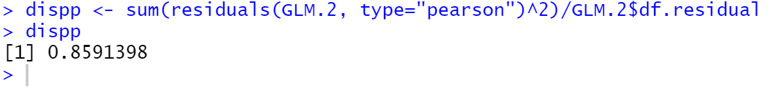
Checking the dispersion parameter
Notes:
Remains one step, which is to verify the dispersion parameter. It has shrunk from 125 to 0.86 so the results of our poisson regression are valid.

Slide 23
Negative binomial regression
GLM.2 <- glm(deaths ~ offset(log(pop)) + smoke + factor(age), family=poisson(log), data=Poisson_smoking_mort)
library(MASS)
GLM.NB <- glm.nb(deaths ~ offset(log(pop)) + smoke + factor(age), data=Poisson_smoking_mort)
Notes:
In this case the dispersion parameter was fine, so no problem. In case it is still far removed from 1, you can opt for a negative binomial model instead of a poisson model. This requires loading the MASS package. Otherwise the command structure is very similar, instead of ‘glm’ use ‘glm.nb’ and specifying the ‘familiy’ is no longer required.

Slide 24
Negative binomial regression
Factor | RR | LL 95%CI | UL 95% CI
(Intercept) | 0.02522239 | 0.022024 | 0.028781
smoke[T.2] | 1.0489654 | 0.956805 | 1.15038
smoke[T.3] | 1.24353163 | 1.153401 | 1.342352
smoke[T.4] | 1.51733651 | 1.403932 | 1.641745
factor(age)[T.2] | 1.73998782 | 1.487788 | 2.036057
factor(age)[T.3] | 2.66548702 | 2.2941 | 3.100678
factor(age)[T.4] | 3.97274343 | 3.501316 | 4.522519
factor(age)[T.5] | 5.22901595 | 4.63393 | 5.922611
factor(age)[T.6] | 7.37554548 | 6.533268 | 8.357305
factor(age)[T.7] | 9.69304149 | 8.558723 | 11.0157
factor(age)[T.8] | 12.9174242 | 11.32621 | 14.77512
factor(age)[T.9] | 17.2346744 | 14.96957 | 19.88636
Notes:
This is the result. As you can see, the results are almost identical to those of poisson regression. Which in this case is logical of course because our poisson model was not over-dispersed.

Slide 25
Summary of lecture
Poisson regression …
Used to model count outcomes and rates
Long and wide format
Wide format requires offset (log of population, pyar)
Models log of rate: log (y) = b₀+b₁x₁+b₂x₂…+b_{i}x_{i}
Condition: mean ≈ variance
Comparison of models, same as for logistic regression
To check for over dispersion calculate dispersion parameter:
sum of squared Pearson residuals/ residual degrees of freedom.
If over-dispersed shift to negative binomial

